Slide 1

SPRING 2018
Class: ENGR 5333 Statistical Principles in Engineering
Project Topic: Data Analysis of Absorption of Photon Flux by Algae
Teacher: Dr Xinyu Liu, Associate Professor
Members of Group 10:
Kaledia Paul Ouattara: Master in Chemical Engineering
……………………………….. : Master in Electrical Engineering
……………………………….. : Master in Electrical Engineering
……………………………….. : Master in Electrical Engineering

Slide 2
Introduction:
Nanotechnology refers to an emerging field of Science that includes synthesis and development of various nanomaterials.
Nanoparticles (NPs) can be defined as a small object that behaves as a whole unit in terms of its transport and properties
Nanoparticles have countless applications in medicine and science. They are used to increase the bone and joint growth, chemotherapy and industry production such as solar and oxide fuel batteries for energy storage.
Synthesis of nanoparticles using algae can be performed in different steps, our analysis is limited to the photon flux absorbed by the algae and predicting its photon flux absorption is sufficient to produce NPs.

Slide 3
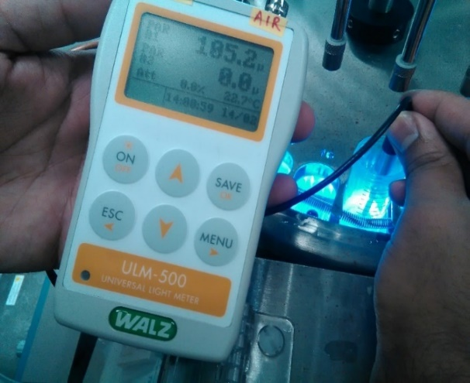
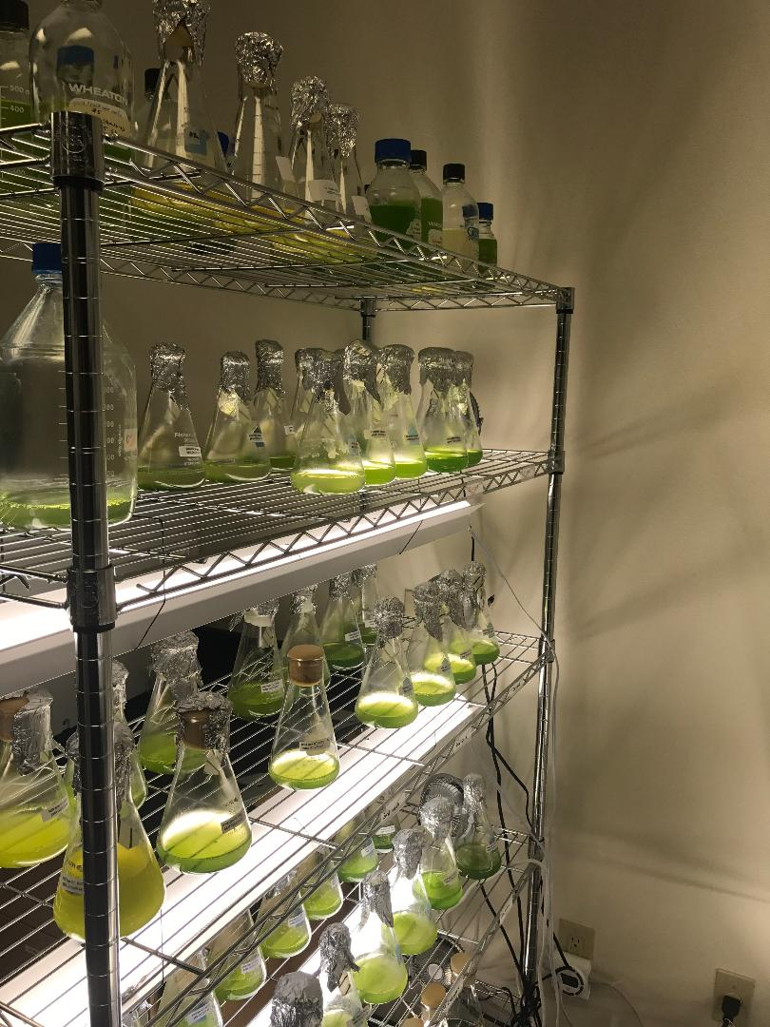
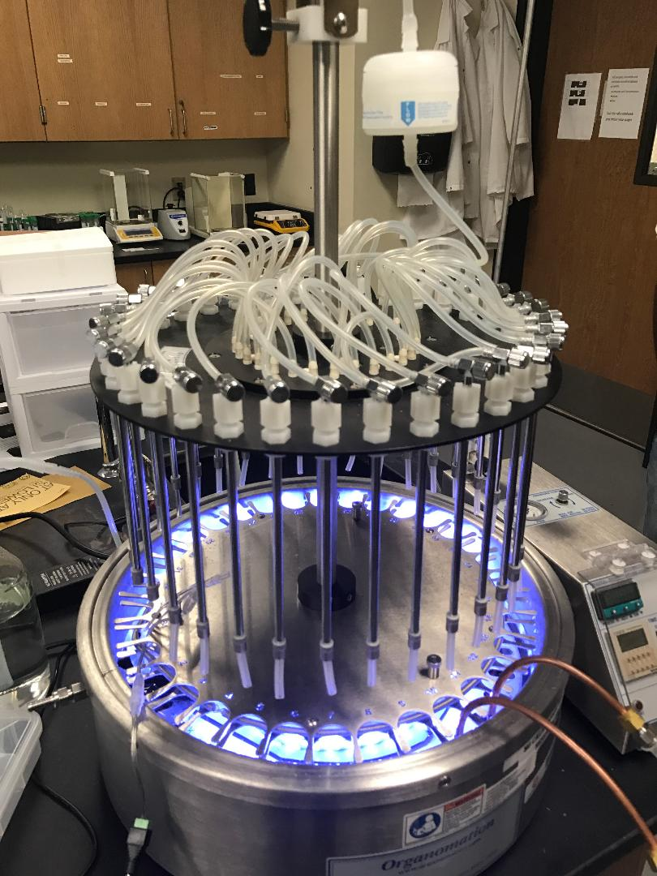
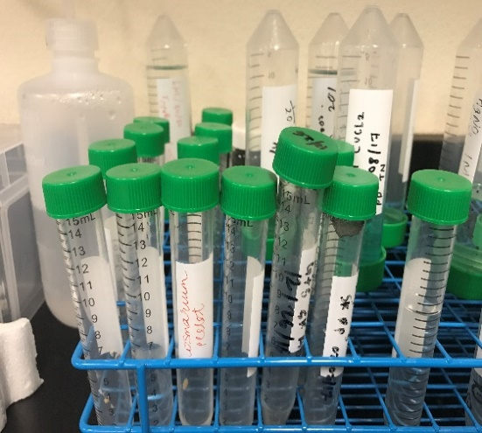
I. PRESENTATION OF PROJECT
Research of a PhD candidate in chemical engineering about production of nanoparticles with algae as catalyst.
Determination of absorption of photon by a culture of algae in an apparatus called Multi-Vessel Reactor (MVR) containing 33 positions of vessels.
Figure 1: Universal light meter reading
Figure 2: Culture of algae (Chlamydomonas reinhardtii)
Figure 3: Multi-Vessel Reactor (MVR)
Figure 4: Vessels

Slide 4
The researcher submitted to us 3 problems:
1. Do the results prove that algae absorb a significant amount of photon?
2. The results are not the same for the different positions as they should be. Can you prove that these values ​​are close enough? If not, determine positions or values ​​are very far from average, to exclude these positions in future experiments.
3. The values ​​of absorption of photon to be exploited, must be greater than the limit of 80 μmol.s⁻¹m⁻² . Is that the case?
4. Some additional experiments were done to compare the impact of day length on photon absorption of culture. The cultures were exposed to different cycles of light and dark (08:16 hours, 10:14h, 12:12h, 14:10h and 16:8h). How does the day length impact the capacity of absorption of algae?
The tools we used to answer these 4 questions are:
For question 1: Confidence intervals on the difference between 2 means (to compare the measurements of photon flux in water and in culture).
For question 2: Box plot (to determine outliers).
For question 3: Hypothesis testing for one variable.
For question 4: Simple linear regression.

Slide 5
II. PRESENTATION OF DATA
Table 1: Photon flux in vessel with water and with culture (μmol.s⁻¹m⁻²)
Vessel position | Photon flux in water | Photon flux in culture
1 | 70 | 36.5
2 | 156.4 | 66.8
3 | 188.9 | 87.1
4 | 184.3 | 97.3
5 | 181.5 | 106
6 | 188.4 | 99.5
7 | 191.5 | 98.8
8 | 182.1 | 95.6
9 | 181.2 | 93.2
10 | 178.5 | 83.4
11 | 170.9 | 85.7
12 | 183.6 | 98.6
13 | 182.4 | 94.6
14 | 175.4 | 99.4
15 | 179.3 | 92.7
16 | 182.8 | 86.8
17 | 183.3 | 105.2
18 | 171.3 | 92.8
Vessel position | Photon flux in water | Photon flux in culture
19 | 190.8 | 97.6
20 | 190.9 | 108.6
21 | 196.8 | 99.3
22 | 167.8 | 86.1
23 | 182.2 | 97.4
24 | 173.3 | 94.6
25 | 173.3 | 85.1
26 | 170.4 | 85.7
27 | 179.2 | 82.1
28 | 190.9 | 83.9
29 | 191.1 | 97
30 | 172.3 | 85.7
31 | 164.5 | 89.9
32 | 130.2 | 69.8
33 | 81 | 44.1
Average μmol.s⁻¹m⁻² | 180.9965517 | 93.43793103
Standard deviation | 8.227066946 | 7.263234905

Slide 6
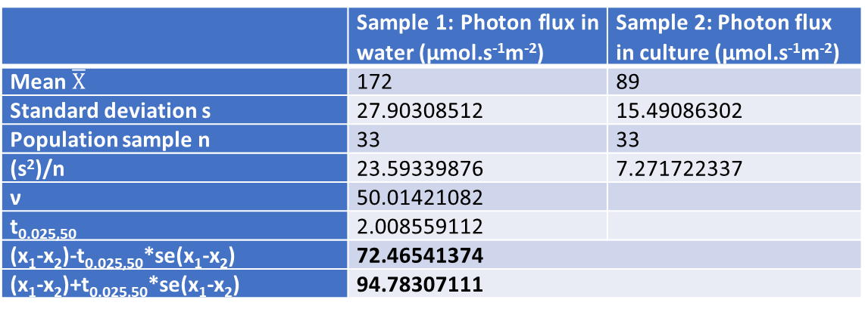
III. ANALYSIS OF DATA
Question 1: Do the results prove that algae absorb a significant amount of photon?
We used the Confidence interval for the difference between means to compare the mean of the measurements of absorption of photon between water and culture of algae.
Table 2: Results of the analysis of Confidence interval for the difference between means
 | Sample 1: Photon flux in water (μmol.s⁻¹m⁻²) | Sample 2: Photon flux in culture (μmol.s⁻¹m⁻²)
Mean $\overline{X}$ | 172 | 89
Standard deviation s | 27.90308512 | 15.49086302
Population sample n | 33 | 33
(s²)/n | 23.59339876 | 7.271722337
ν | 50.01421082
t_{0.025,50} | 2.008559112
(x₁-x₂)-t_{0.025,50}*se(x₁-x₂) | 72.46541374
(x₁-x₂)+t_{0.025,50}*se(x₁-x₂) | 94.78307111
The confidence interval for the difference of means of photon flux between water and culture of algae is [72.465; 94.783]. This interval:
Is positive: we are 95% confident that the values of photon flux in water is higher than in culture;
Does not contain 0: we are 95% confident that the values of photon flux in water and in culture are different.
These results show that the culture of algae absorb a quantity significantly important of photon flux. So, this culture algae can be use as catalyst to produce some nanoparticles instead of toxic metals.

Slide 7
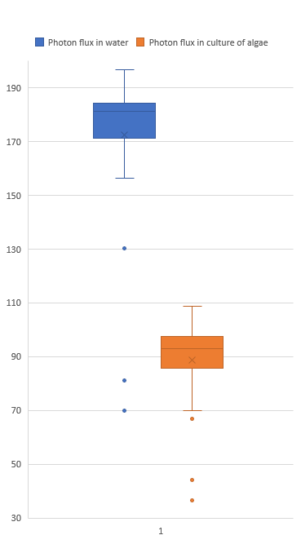
Question 2: The results are not the same for the different positions as they should be. Can you prove that these values ​​are close enough? If not, determine positions or values ​​are very far from average, to exclude these positions in future experiments.
We used box plot to determine outliers.
Photon flux in water: Population size: 33 ; Median: 181.2 Minimum: 70 ; Maximum: 196.8 First quartile: 171.1 ; Third quartile: 186.35 Interquartile Range: 15.25 Outliers: Vessel 1: 70 Vessel 32: 130.2 Vessel 33: 81.0
Photon flux in culture: Sample size: 33 ; Median: 92.8 Minimum: 36.5 ; Maximum: 108.6 First quartile: 85.4 ; Third quartile: 98.1 Interquartile Range: 12.7 Outliers: Vessel 1: 36.5 Vessel 2: 66.8 Vessel 33: 44.1
This descriptive analysis shows that 4 vessel positions give values very far from the others: 1, 2, 32 and 33. These positions should be excluded for further analysis.
Figure 6: Box plots of photon flux in water and culture of algae

Slide 8
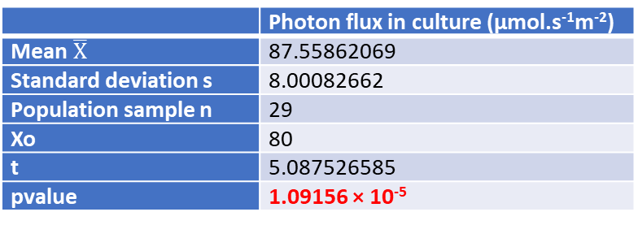
Question 3: The values of absorption of photon to be exploited, must be greater than the limit of 80 μmol.s⁻¹m⁻². Is that the case?
The analysis of hypothesis testing for one variable was used:
Null hypothesis (H₀): μ ≤ 80 ; Alternative hypothesis (H₁): μ > 80.
Table 3: Photon flux in vessel 3-31 without
outliers in culture (μmol.s⁻¹m⁻²)
Table 4: Results of the analysis of hypothesis testing for one variable (means of culture)
Vessel position | Photon flux in culture | Vessel position | Photon flux in culture
3 | 101.8 | 18 | 78.5
4 | 87 | 19 | 93.2
5 | 75.5 | 20 | 82.3
6 | 88.9 | 21 | 97.5
7 | 92.7 | 22 | 81.7
8 | 86.5 | 23 | 84.8
9 | 88 | 24 | 78.7
10 | 95.1 | 25 | 88.2
11 | 85.2 | 26 | 84.7
12 | 85 | 27 | 97.1
13 | 87.8 | 28 | 107
14 | 76 | 29 | 94.1
15 | 86.6 | 30 | 86.6
16 | 96 | 31 | 74.6
17 | 78.1
 | Photon flux in culture (μmol.s⁻¹m⁻²)
Mean $\overline{X}$ | 87.55862069
Standard deviation s | 8.00082662
Population sample n | 29
Xo | 80
t | 5.087526585
pvalue | 1.09156 × 10⁻⁵
The p-value ≤ 0.05 so we can reject the null hypothesis.
Therefore, we can say that the values of photon absorption can be exploited because their mean are greater than the limit of 80 μmol.s⁻¹m⁻².

Slide 9
Question 4: Some additional experiments were done to compare the impact of day length on photon absorption of culture. The cultures were exposed during production to different cycles of light and dark (08:16 hours, 10:14h, 12:12h, 14:10h and 16:8h). How does the day length impact the capacity of absorption of algae?
Table 5: Absorption of photon by culture with different light exposition during production
Vessel position | Day length 8:16h | Day length 10:14h | Day length 12:12h | Day length 14:8h | Day length 16:8h
3 | 101.8 | 114.8 | 145.6 | 159.4 | 184.5
4 | 87 | 104.7 | 151.3 | 147.9 | 176.6
5 | 75.5 | 91.9 | 156.3 | 164.7 | 189.5
6 | 88.9 | 106.1 | 127.8 | 137.3 | 164.2
7 | 92.7 | 115.7 | 139.3 | 152.8 | 164.8
8 | 86.5 | 109.0 | 138.3 | 152.7 | 171.3
9 | 88 | 110.7 | 125.3 | 133.1 | 169.6
10 | 95.1 | 112.8 | 141.7 | 168.0 | 194.6
11 | 85.2 | 101.9 | 128.4 | 156.7 | 170.9
12 | 85 | 102.4 | 144.8 | 157.4 | 171.0
13 | 87.8 | 101.3 | 138.1 | 148.7 | 162.6
14 | 76 | 102.8 | 132.0 | 145.5 | 175.3
15 | 86.6 | 99.7 | 139.3 | 154.4 | 177.4
16 | 96 | 110.4 | 141.5 | 145.7 | 160.1
17 | 78.1 | 100.1 | 137.4 | 138.3 | 161.5
18 | 78.5 | 107.8 | 135.4 | 147.7 | 165.3
19 | 93.2 | 103.5 | 137.1 | 148.7 | 178.3
20 | 82.3 | 108.2 | 136.7 | 152.1 | 173.4
21 | 97.5 | 110.6 | 142.2 | 137.7 | 161.8
22 | 81.7 | 103.2 | 154.1 | 155.7 | 175.9
23 | 84.8 | 101.1 | 139.0 | 154.3 | 173.0
24 | 78.7 | 99.2 | 131.1 | 131.1 | 163.1
25 | 88.2 | 107.6 | 128.1 | 145.0 | 179.4
26 | 84.7 | 100.4 | 134.0 | 152.4 | 185.0
27 | 97.1 | 120.5 | 150.0 | 149.1 | 188.9
28 | 107 | 129.8 | 164.1 | 170.0 | 185.9
29 | 94.1 | 116.4 | 141.1 | 150.1 | 169.6
30 | 86.6 | 102.9 | 146.7 | 162.2 | 183.5
31 | 74.6 | 99.1 | 140 | 150.6 | 185.2
Average μmol.s⁻¹m⁻² | 87.55 | 106.69 | 140.27 | 150.66 | 174.55
Standard deviation | 8.00 | 7.74 | 8.978 | 9.50 | 9.64
We used simple linear regression to show the impact of different light exposition on the absorption of algae.
Table 6: Mean of absorption of photon by culture with different light exposition during production
Light exposition (hours) | Mean of photon absorption
8 | 87.55862069
10 | 106.6976715
12 | 140.274033
14 | 150.6629743
16 | 174.5581831

Slide 10
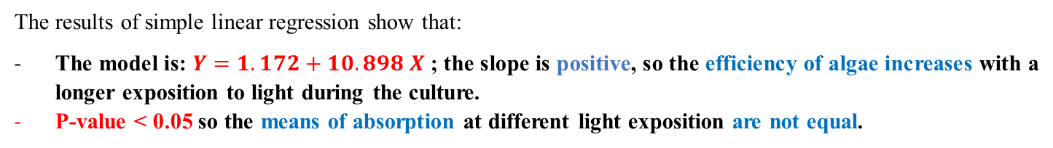
Table 7: Results of simple linear regression
The results of simple linear regression show that:
The model is: $Y=1.172+10.898 X$ ; the slope is positive, so the efficiency of algae increases with a longer exposition to light during the culture.
P-value < 0.05 so the means of absorption at different light exposition are not equal.

Slide 11
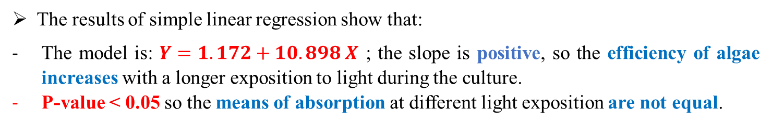
CONCLUSION
The culture of algae absorbs a quantity significantly important of photon flux.
Four vessel positions give values very far from the others: 1, 2, 32 and 33. These positions should be excluded for further analysis.
The values of photon absorption can be exploited because their mean are greater than the limit of 80 μmol.s⁻¹m⁻².
The results of simple linear regression show that:
The model is: $Y=1.172+10.898 X$ ; the slope is positive, so the efficiency of algae increases with a longer exposition to light during the culture.
P-value < 0.05 so the means of absorption at different light exposition are not equal.

Slide 12
References:
Si AmarDahoumane, Evan K.Wujcik and ClaytonJeffryes, Noble metal, oxide and chalcogenide-based nanomaterials from scalable phototrophic culture systems, Enzyme and Microbial Technology Volume 95, December 2016, Pages 13-27
Pouya Asrar, Marta Sucur and Nastaran Hashemi, Multi-Pixel Photon Counters for Optofluidic Characterization of Particles and Microalgae, Biosensors 2015, 5, 308-318; doi:10.3390/bios5020308
G. Mitsue León-Saikia,⁎, Tània Cabrero Martía, Douwe van der Veena, René H. Wijffelsa, Dirk E. Martensa , The impact of day length on cell division and efficiency of light use in a starchless mutant of Tetradesmus obliquus, Algal Research, Volume 31, April 2018, Pages 387-394]

Slide 13
Thank You

